Slide 1

REVOLUTIONIZING SERVICE, SALES, AND MAINTENANCE IN COMPUTER MATERIALS MANAGEMENT – A DYNAMIC WEB AND MOBILE APPLICATION
WebMet+
A Unified Software Solution for Computer Materials and Service Management on the Web.

Slide 2




Meet The Team
NKATEKEH BLAISE:
Cyber Security Expert
CHIA CARLSON:
Software Engineer
KOLLE DORIS:
System Analyst / Architect
JEFFERSON CLINTON Y. :
Software Engineer
KETU CONFIDENCE:
UI/UX Design
JEFFERSON CLINTON Y.
CHIA CARLSON
NKATEKEH BLAISE
KOLLE DORIS

Slide 3
AGENDA
1
Objectives
2
Functional requirements
3
Non-functional requirements
4
Plan and life cycle
5
Security measures
6
Gantt chat graph
UML diagrams(use-case, sequence, class and activity diagrams
7

Slide 4
Objective
Application for the management of services, selling and maintenance of computer material.

Slide 5
Specific Objectives
2. Develop a portal to seamlessly manage service requests, sales transactions and maintenance tasks for computer materials.
3. Establish a robust system with secure user authentication, access control, and compliance with privacy regulations, ensuring scalability to accommodate future growth.
1. Design a user-friendly interface with features for efficient service prioritization, sales tracking inventory management and maintenance monitoring
4. Implement reporting tools for analyzing sales service and data maintenance:

Slide 6

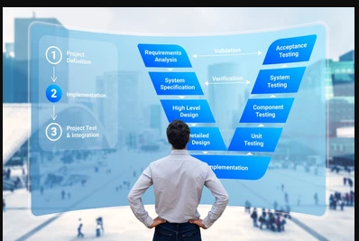
Human resources slide 3
Administrator:
CRUD products
Monitors activities, assigns tasks, permissions and administrative roles.
Customers:
View products
Rate product and delivery quality
View and update personal accounts
Service Technicians:
Receives Orders
Delivers products
Delivery Agents
Manages service requests
Prioritize tasks and communicates with customers
Payment Gateway
Access payment
Process payment
System(Automated)
Logout users, after 10mins of inactivity.
Implement and maintain security protocols
Functional Requirements

Slide 7
NON-FUNCTIONAL REQUIREMENTS
Performan-ce
Performance It should respond to interactions within 2 secs to ensure a responsive experience
.
Security: User data, and financial information must be encrypted during transmission and storage
.
Security
Scalabili-ty
Scalability : It should be able to accommodate a 50% growth in user base, and data volume over the next two years.

Slide 8

LIFE CYCLE/PLAN
AGILE METHODOLOGY
25%
50%
75%
100%
Week 1
Week 2
Week 3
Week 4
Initiate project with stake holders, outline system architecture, and commence interface development or web and mobile platforms, followed by testing and user acceptance
Develop UI wireframes, implement responsive design, and conduct training sessions for administrators and end – users while monitoring and resolving deployment issues.
Conduct feasibility study, establish database and server architecture, implement core functions, involve stakeholders in UAT, perform final testing, and provide ongoing user support post-deployment.
Develop Project plan, prototype key features, integrate component for testing, monitor for any deployment issues and monitor system performance and address any challenges

Slide 9

SECURITY MEASURES
Safeguarding the Security puzzle with encrypted pieces.
Our Security Measures
Three step authentication, password, email and OTP confirmation.
Encryption of sensitive data.
Tracking of passages delivered.
Logging out of users, after 10mins of inactivity.
System is constantly under updates to ensure maximum efficiency of the application.

Slide 10
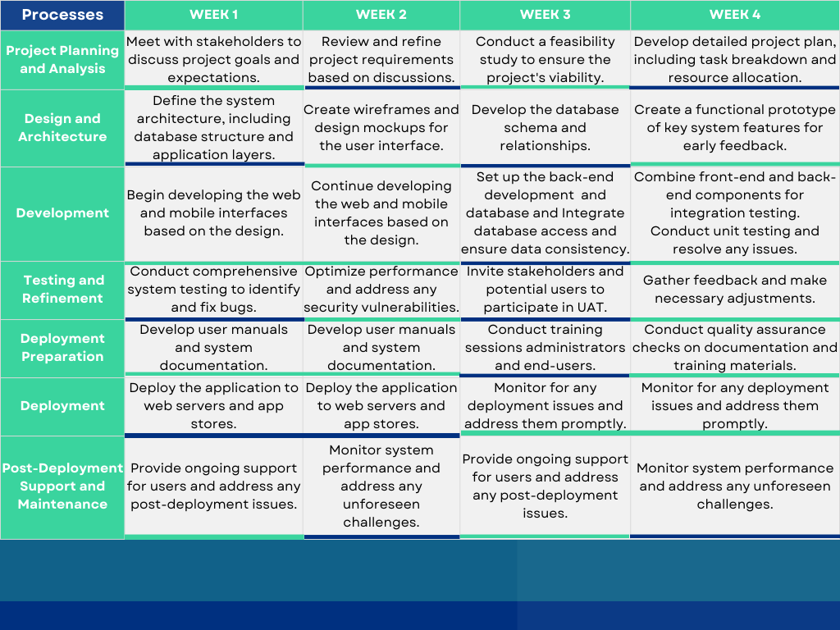
GANTT CHART
GANTT CHART

Slide 11
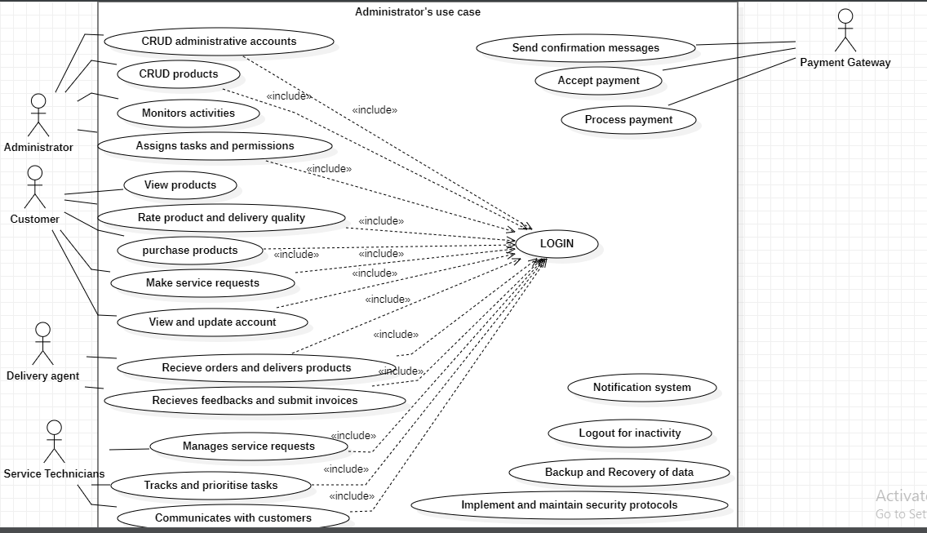
Human resources slide 10
USE-CASE DIAGRAM

Slide 12
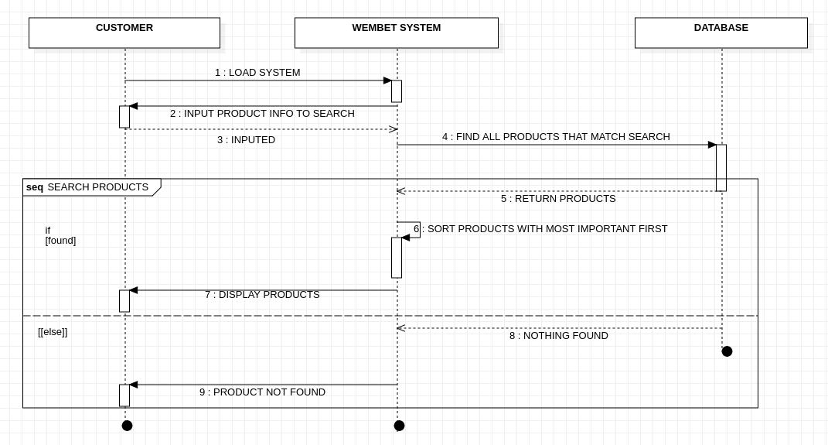
SEQUENCE DIAGRAM
A customer searching for a product

Slide 13
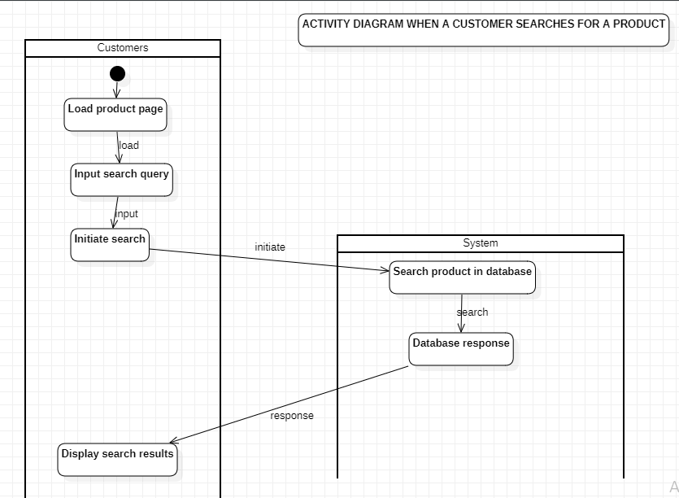
Human resources slide 10
ACTIVITY DIAGRAM

Slide 14
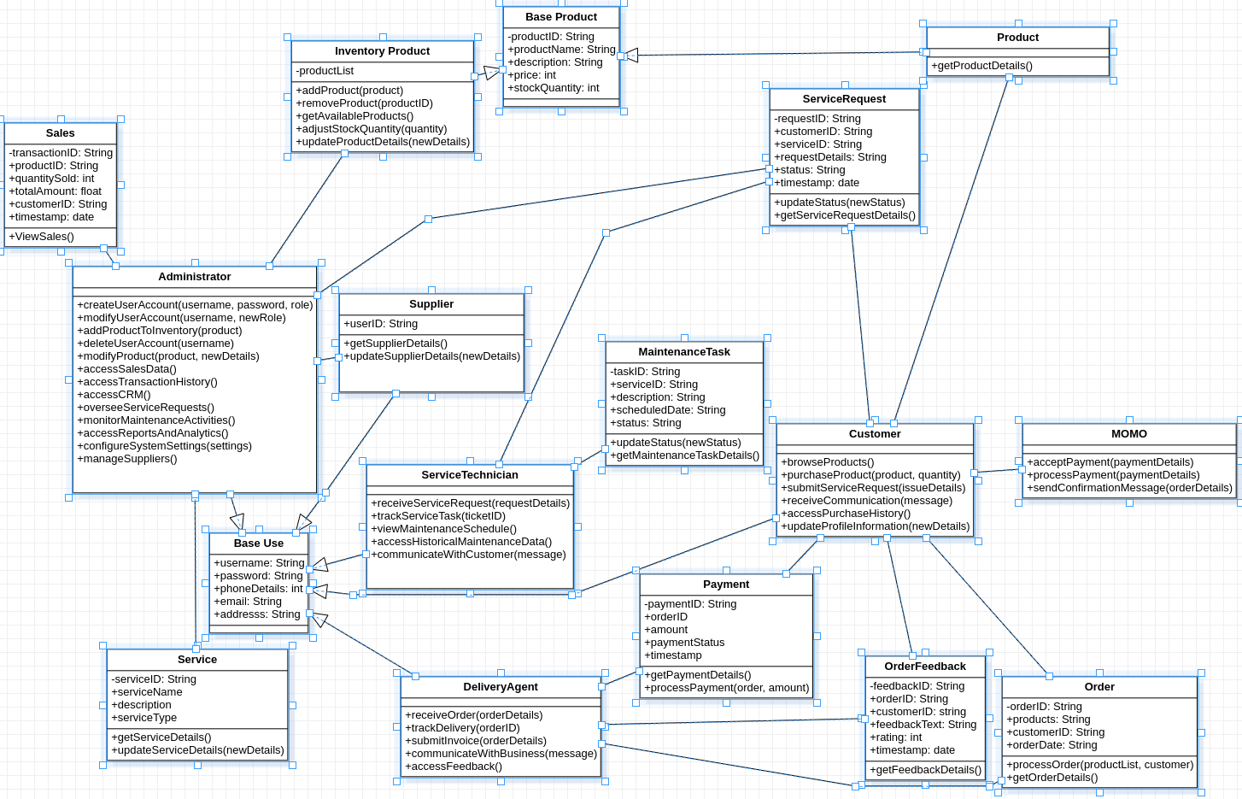
CLASS DIAGRAM

Slide 15
Thank You
~~Unleashing limitless learning through technology – where innovation sparks inspiration and education becomes an extraordinary journey.~~

